Slide 1
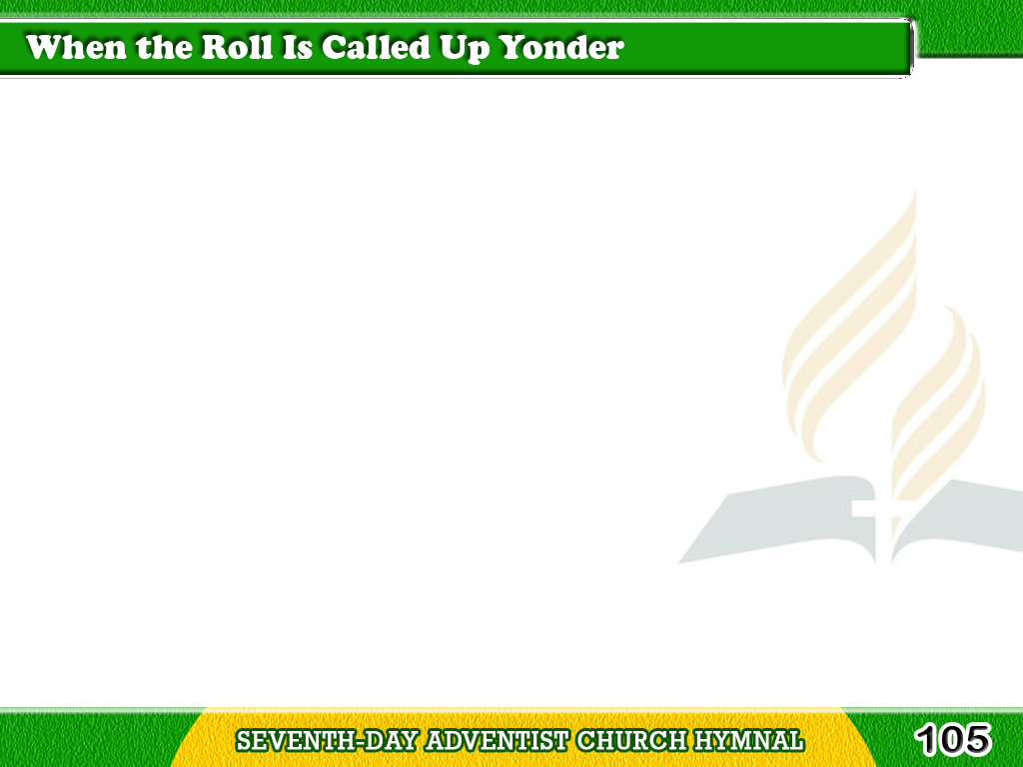
1/3
When the trumpet
of the Lord shall sound,
and time shall be no more,
And the morning breaks,
eternal, bright and fair;
Tagalog
Version

Slide 2
1/3
When the saved of earth shall
gather over on the other shore,
And the roll is called up yonder,
I’ll be there.
Tagalog
Version

Slide 3
1/3
Chorus
When the roll is called up yonder,
When the roll is called up yonder,
When the roll is called up yonder,
When the roll is called up yonder,
I’ll be there.
Tagalog
Version

Slide 4
2/3
On that bright
and cloudless morning,
when the dead in Christ shall rise,
And the glory
of His resurrection share;
Tagalog
Version

Slide 5
2/3
When His chosen
ones shall gather
to their home beyond the skies,
And the roll is called up yonder,
I’ll be there.
Tagalog
Version

Slide 6
2/3
When the roll is called up yonder,
When the roll is called up yonder,
When the roll is called up yonder,
When the roll is called up yonder,
I’ll be there.
Tagalog
Version

Slide 7
3/3
Let us labor for the Master
from the dawn till setting sun,
Let us talk of all
His wondrous love and care,
Tagalog
Version

Slide 8
3/3
Then, when all of life is over,
and our work on earth is done,
And the roll is called up yonder,
I’ll be there.
Tagalog
Version

Slide 9
3/3
Chorus
When the roll is called up yonder,
When the roll is called up yonder,
When the roll is called up yonder,
When the roll is called up yonder,
I’ll be there.
Tagalog
Version

